Slide 1
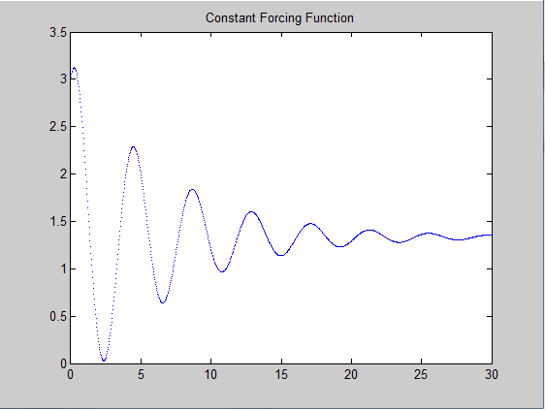
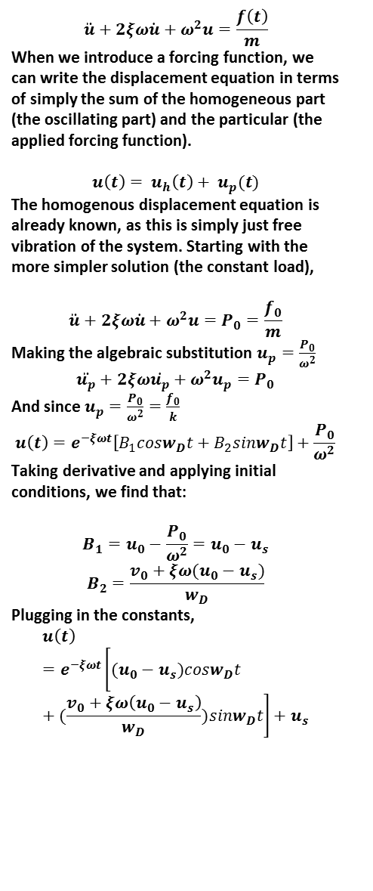
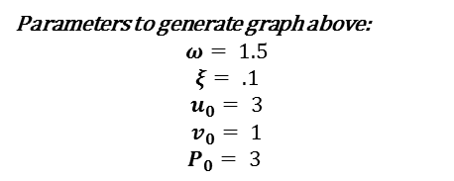
SDOF Oscillator (damping) with Constant and Sinusoidal Forcing Function (CFF,SFF)
To create an oscillator with a SFF, the free body diagram must be constructed. We can use the same EOM from the previous homework, except now we must account for f(t).
$$\ddot{u}+2ξω\dot{u}+ω^{2}u=\frac{f\left(t\right)}{m}$$
When we introduce a forcing function, we can write the displacement equation in terms of simply the sum of the homogeneous part (the oscillating part) and the particular (the applied forcing function).
$$u\left(t\right)= u_{h}\left(t\right)+ u_{p}(t)$$
The homogenous displacement equation is already known, as this is simply just free vibration of the system. Starting with the more simpler solution (the constant load),
$$\ddot{u}+2ξω\dot{u}+ω^{2}u=P_{0}=\frac{f_{0}}{m}$$
Making the algebraic substitution $u_{p}=\frac{P_{0}}{ω^{2}}$
$$\ddot{u_{p}}+2ξω\dot{u_{p}}+ω^{2}u_{p}=P_{0}$$
And since $u_{p}=\frac{P_{0}}{ω^{2}}=\frac{f_{0}}{k}$
$$u\left(t\right)=e^{−ξωt}\left[B_{1}cosw_{D}t+B_{2}sinw_{D}t\right]+\frac{P_{0}}{ω^{2}}$$
Taking derivative and applying initial conditions, we find that:
$$B_{1}=u_{0}−\frac{P_{0}}{ω^{2}}=u_{0}−u_{s}$$
$$B_{2}=\frac{v_{0}+ξω(u_{0}−u_{s})}{w_{D}}$$
Plugging in the constants,
$$u\left(t\right)=e^{−ξωt}\left[(u_{0}−u_{s})cosw_{D}t+(\frac{v_{0}+ξω\left(u_{0}−u_{s}\right)}{w_{D}})sinw_{D}t\right]+u_{s}$$
Parameters to generate graph above:
$$ω= 1.5$$
$$ξ= .1$$
$$u_{0}= 3$$
$$v_{0}= 1$$
$$P_{0}= 3$$

Slide 2
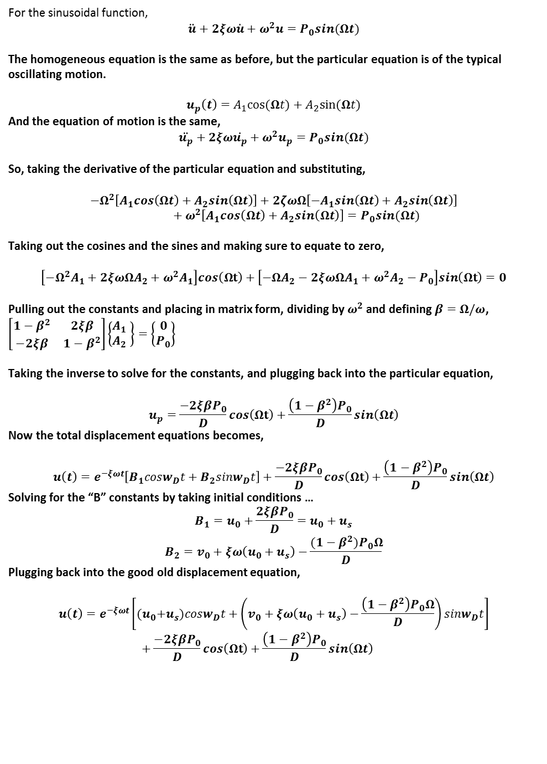
For the sinusoidal function,
$$\ddot{u}+2ξω\dot{u}+ω^{2}u=P_{0}sin(Ωt)$$
The homogeneous equation is the same as before, but the particular equation is of the typical oscillating motion.
$$u_{p}\left(t\right)=A_{1}cos⁡(Ωt)+A_{2}sin⁡(Ωt)$$
And the equation of motion is the same,
$$\ddot{u_{p}}+2ξω\dot{u_{p}}+ω^{2}u_{p}=P_{0}sin(Ωt)$$
So, taking the derivative of the particular equation and substituting,
$$−Ω^{2}\left[A_{1}cos\left(Ωt\right)+A_{2}sin\left(Ωt\right)\right]+2ζωΩ\left[−A_{1}sin\left(Ωt\right)+A_{2}sin\left(Ωt\right)\right]+ω^{2}\left[A_{1}cos\left(Ωt\right)+A_{2}sin\left(Ωt\right)\right]=P_{0}sin(Ωt)$$
Taking out the cosines and the sines and making sure to equate to zero,
$$\left[−Ω^{2}A_{1}+2ξωΩA_{2}+ω^{2}A_{1}\right]cos\left(Ωt\right)+\left[−ΩA_{2}−2ξωΩA_{1}+ω^{2}A_{2}−P_{0}\right]sin\left(Ωt\right)=0$$
Pulling out the constants and placing in matrix form, dividing by $ω^{2}$ and defining $β=Ω/ω$,
$\left[\begin{matrix}1−β^{2} & 2ξβ \\ −2ξβ & 1−β^{2}\end{matrix}\right]\left\{\begin{matrix}A_{1} \\ A_{2} \end{matrix}\right\}=\left\{\begin{matrix}0 \\ P_{0}\end{matrix}\right\}$
Taking the inverse to solve for the constants, and plugging back into the particular equation,
$$u_{p}=\frac{−2ξβP_{0}}{D}cos\left(Ωt\right)+\frac{\left(1−β^{2}\right)P_{0}}{D}sin\left(Ωt\right)$$
Now the total displacement equations becomes,
$$u\left(t\right)=e^{−ξωt}\left[B_{1}cosw_{D}t+B_{2}sinw_{D}t\right]+\frac{−2ξβP_{0}}{D}cos\left(Ωt\right)+\frac{\left(1−β^{2}\right)P_{0}}{D}sin\left(Ωt\right)$$
Solving for the “B” constants by taking initial conditions …
$$B_{1}=u_{0}+\frac{2ξβP_{0}}{D}=u_{0}+u_{s}$$
$$B_{2}=v_{0}+ξω\left(u_{0}+u_{s}\right)−\frac{(1−β^{2})P_{0}Ω}{D}$$
Plugging back into the good old displacement equation,
$$u\left(t\right)=e^{−ξωt}\left[{(u}_{0}+u_{s})cosw_{D}t+\left(v_{0}+ξω\left(u_{0}+u_{s}\right)−\frac{\left(1−β^{2}\right)P_{0}Ω}{D}\right)sinw_{D}t\right]+\frac{−2ξβP_{0}}{D}cos\left(Ωt\right)+\frac{\left(1−β^{2}\right)P_{0}}{D}sin\left(Ωt\right)$$

Slide 3
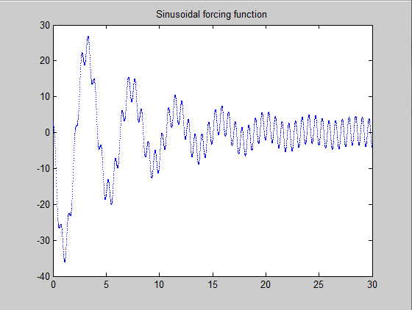
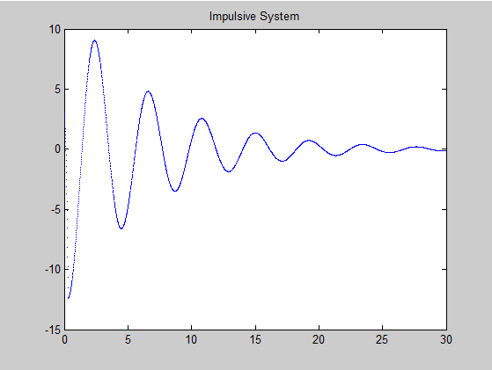
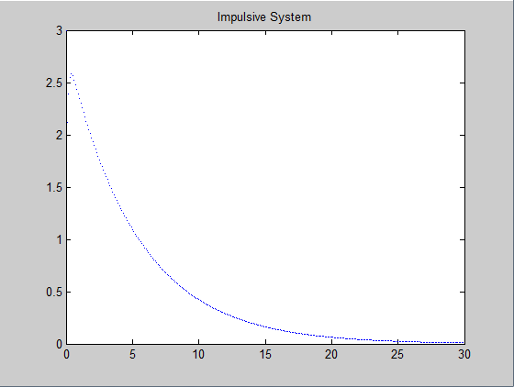
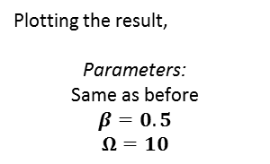
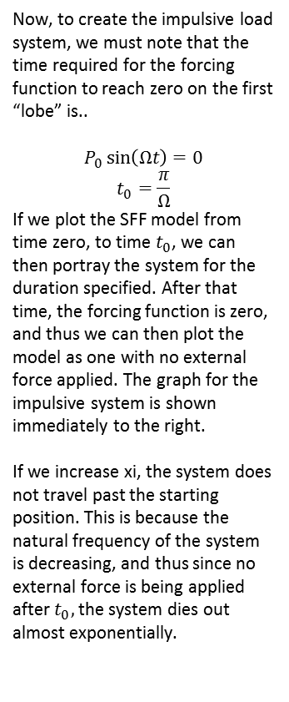
Plotting the result,
Parameters:
Same as before
$$β=0.5$$
$$Ω=10$$
Now, to create the impulsive load system, we must note that the time required for the forcing function to reach zero on the first “lobe” is..
$$P_{0}\sin\left(Ωt\right)=0$$
$$t_{0}=\frac{π}{Ω}$$
If we plot the SFF model from time zero, to time $t_{0}$, we can then portray the system for the duration specified. After that time, the forcing function is zero, and thus we can then plot the model as one with no external force applied. The graph for the impulsive system is shown immediately to the right.
If we increase xi, the system does not travel past the starting position. This is because the natural frequency of the system is decreasing, and thus since no external force is being applied after $t_{0},$the system dies out almost exponentially.

Slide 4
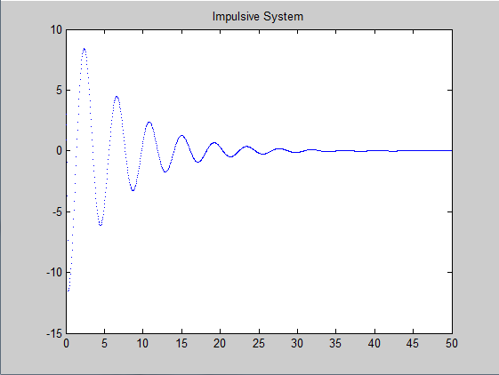
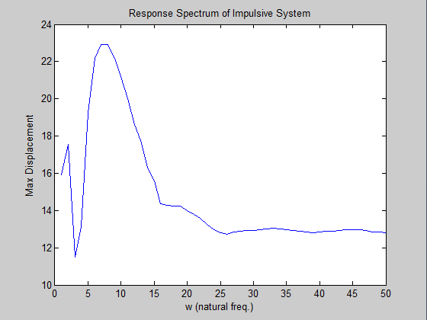
If we adjust the duration, we notice that the model eventually damps out. If we change the amplitude, it is interesting to note that the model stops moving at almost the same time as a model with less of an applied force.
The response spectrum as a function of the natural frequency is quite interesting! The response simply is not a function of the duration. Changing the duration will not change the response of the system.
Is the area under the load-time curve an important organizing value for the response?

